Slide 1
Topic Modeling
By: Julio, Ama, Lu

Slide 2
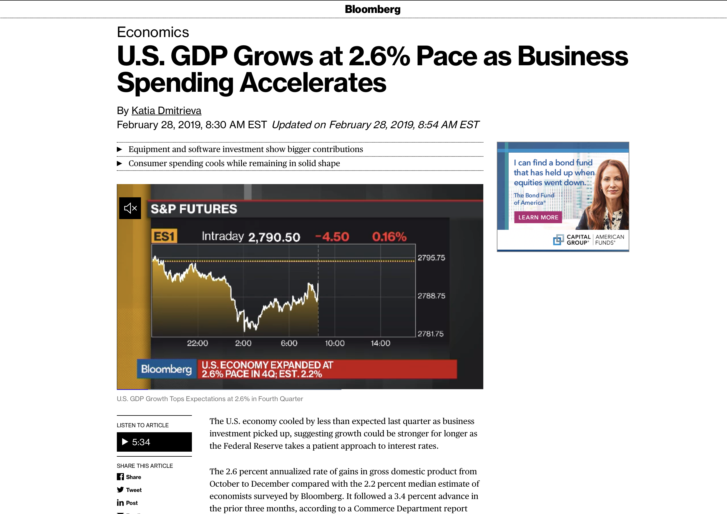
The Journey from Online Articles to CSVs

Slide 3
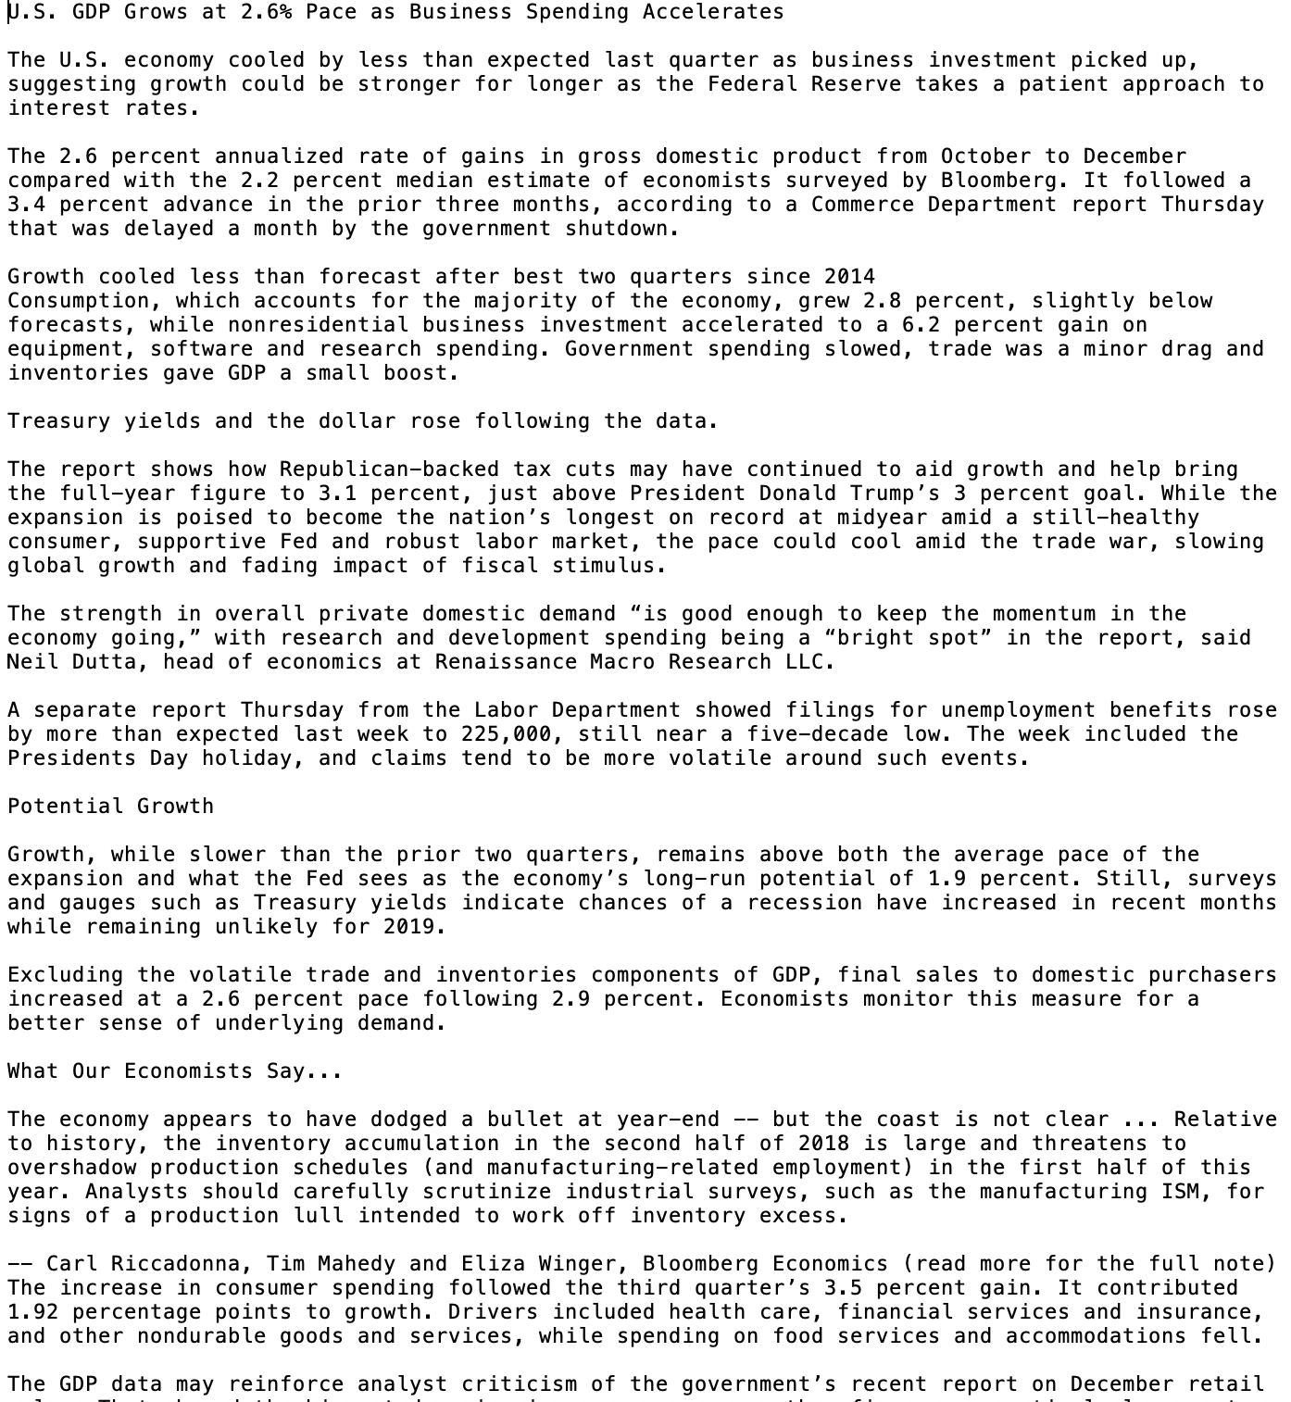
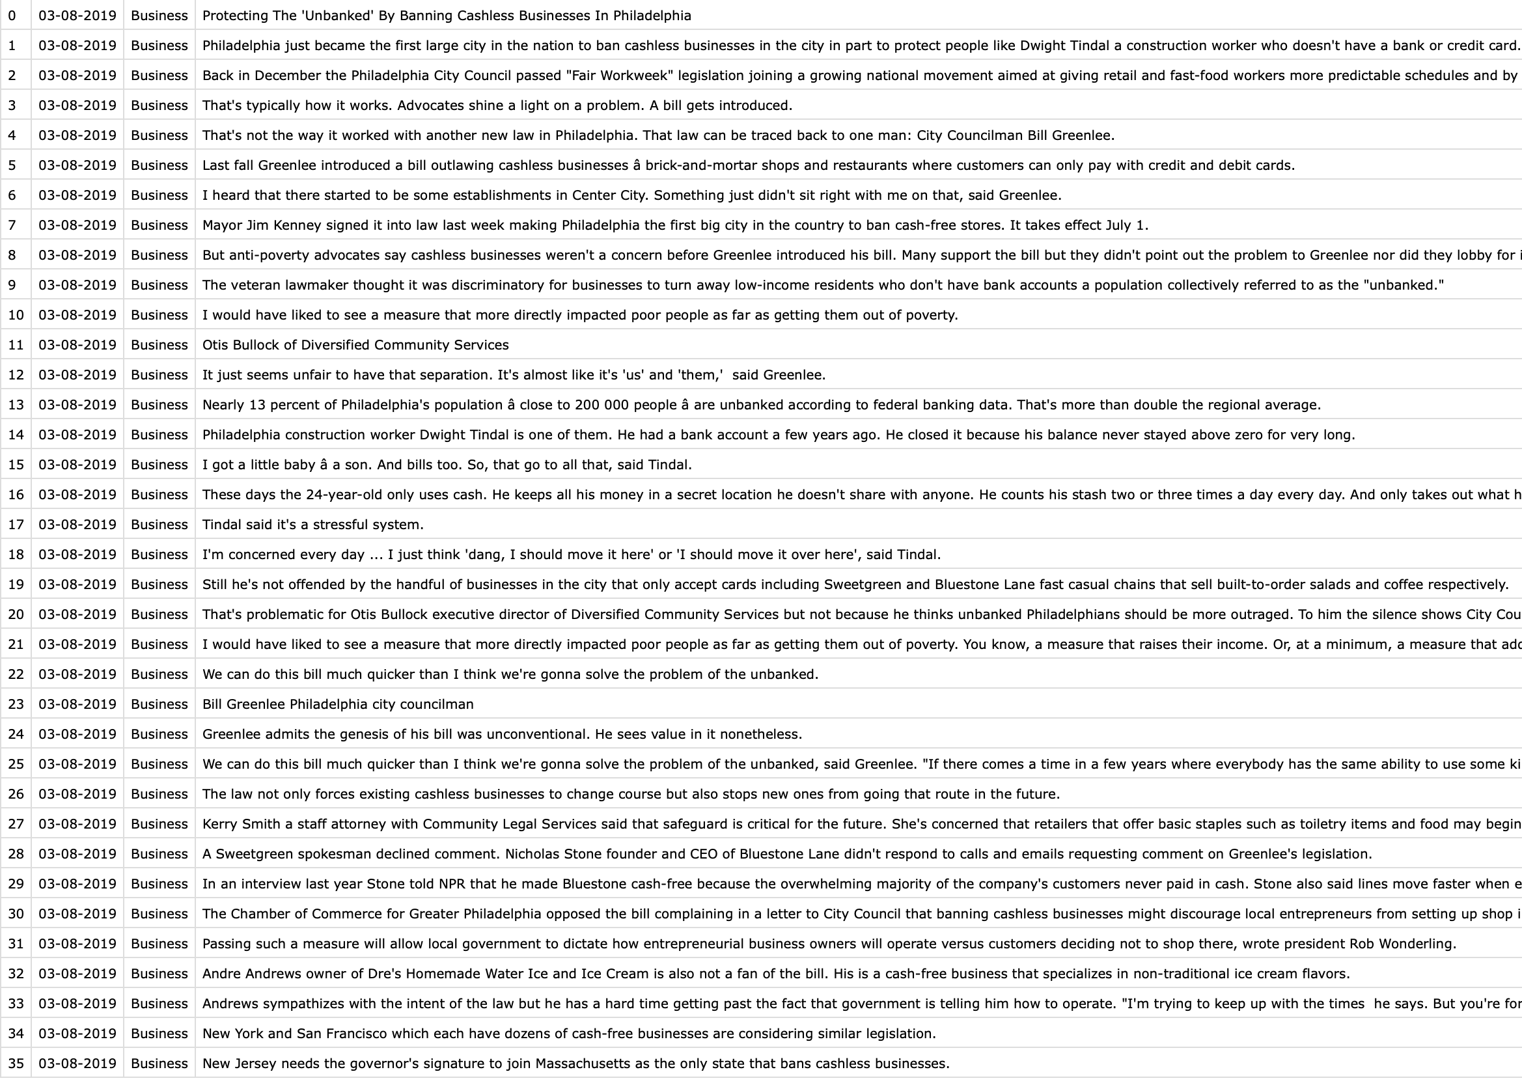
The Journey from Online Articles to CSVs

Slide 4
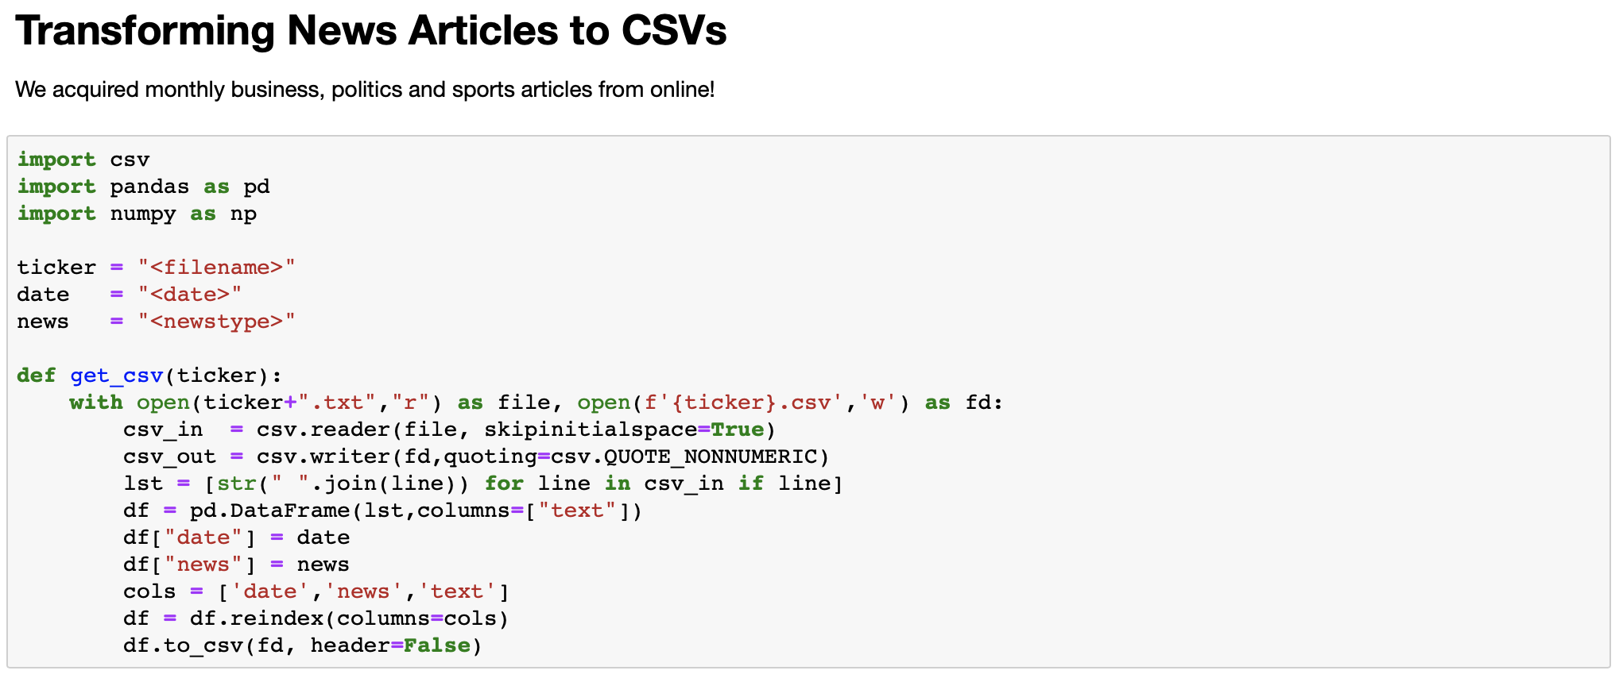
The Journey from Online Articles to CSVs

Slide 5
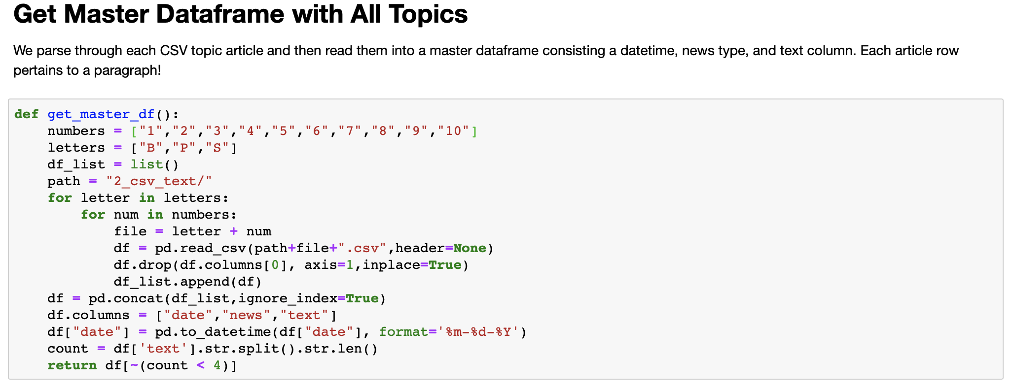
CSVs to Pandas Dataframe

Slide 6
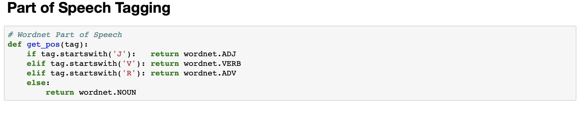
Pre-Processing Step I - Function Set Up

Slide 7
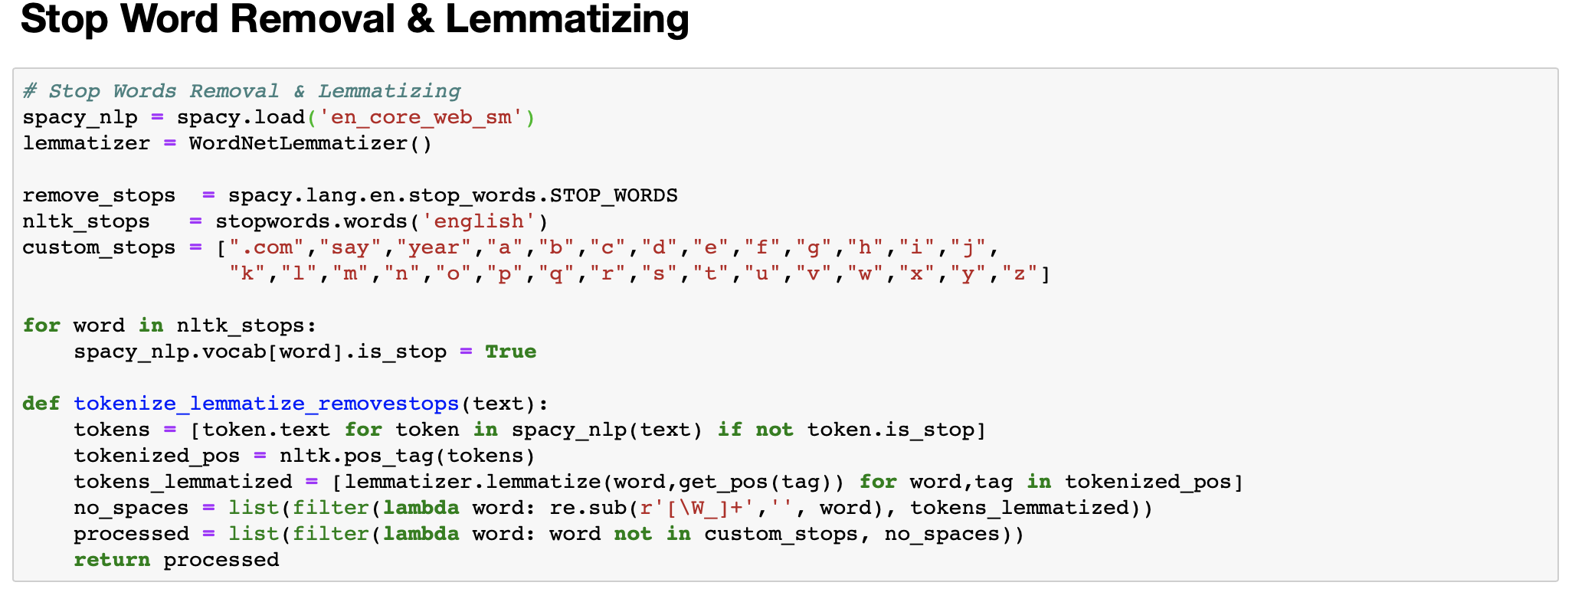
Pre-Processing Step II - More Function Set Up

Slide 8
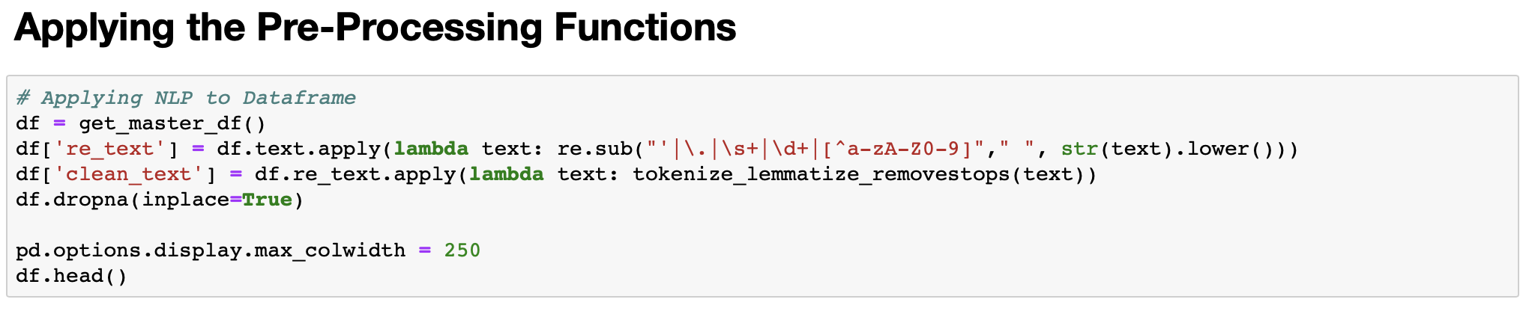
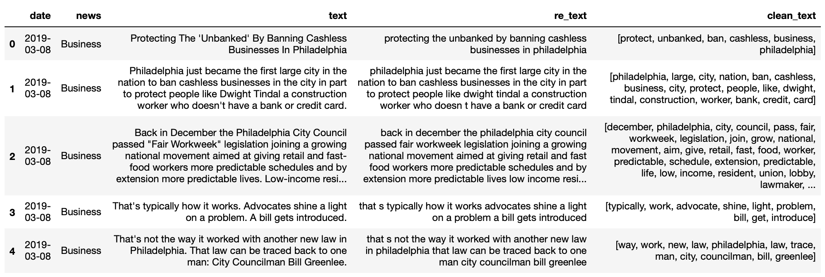
Pre-Processing Step III

Slide 9
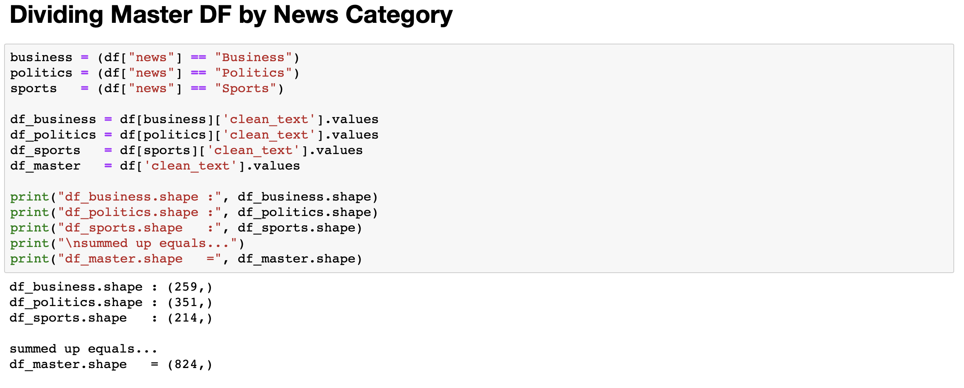
Pre-Processing IV

Slide 10
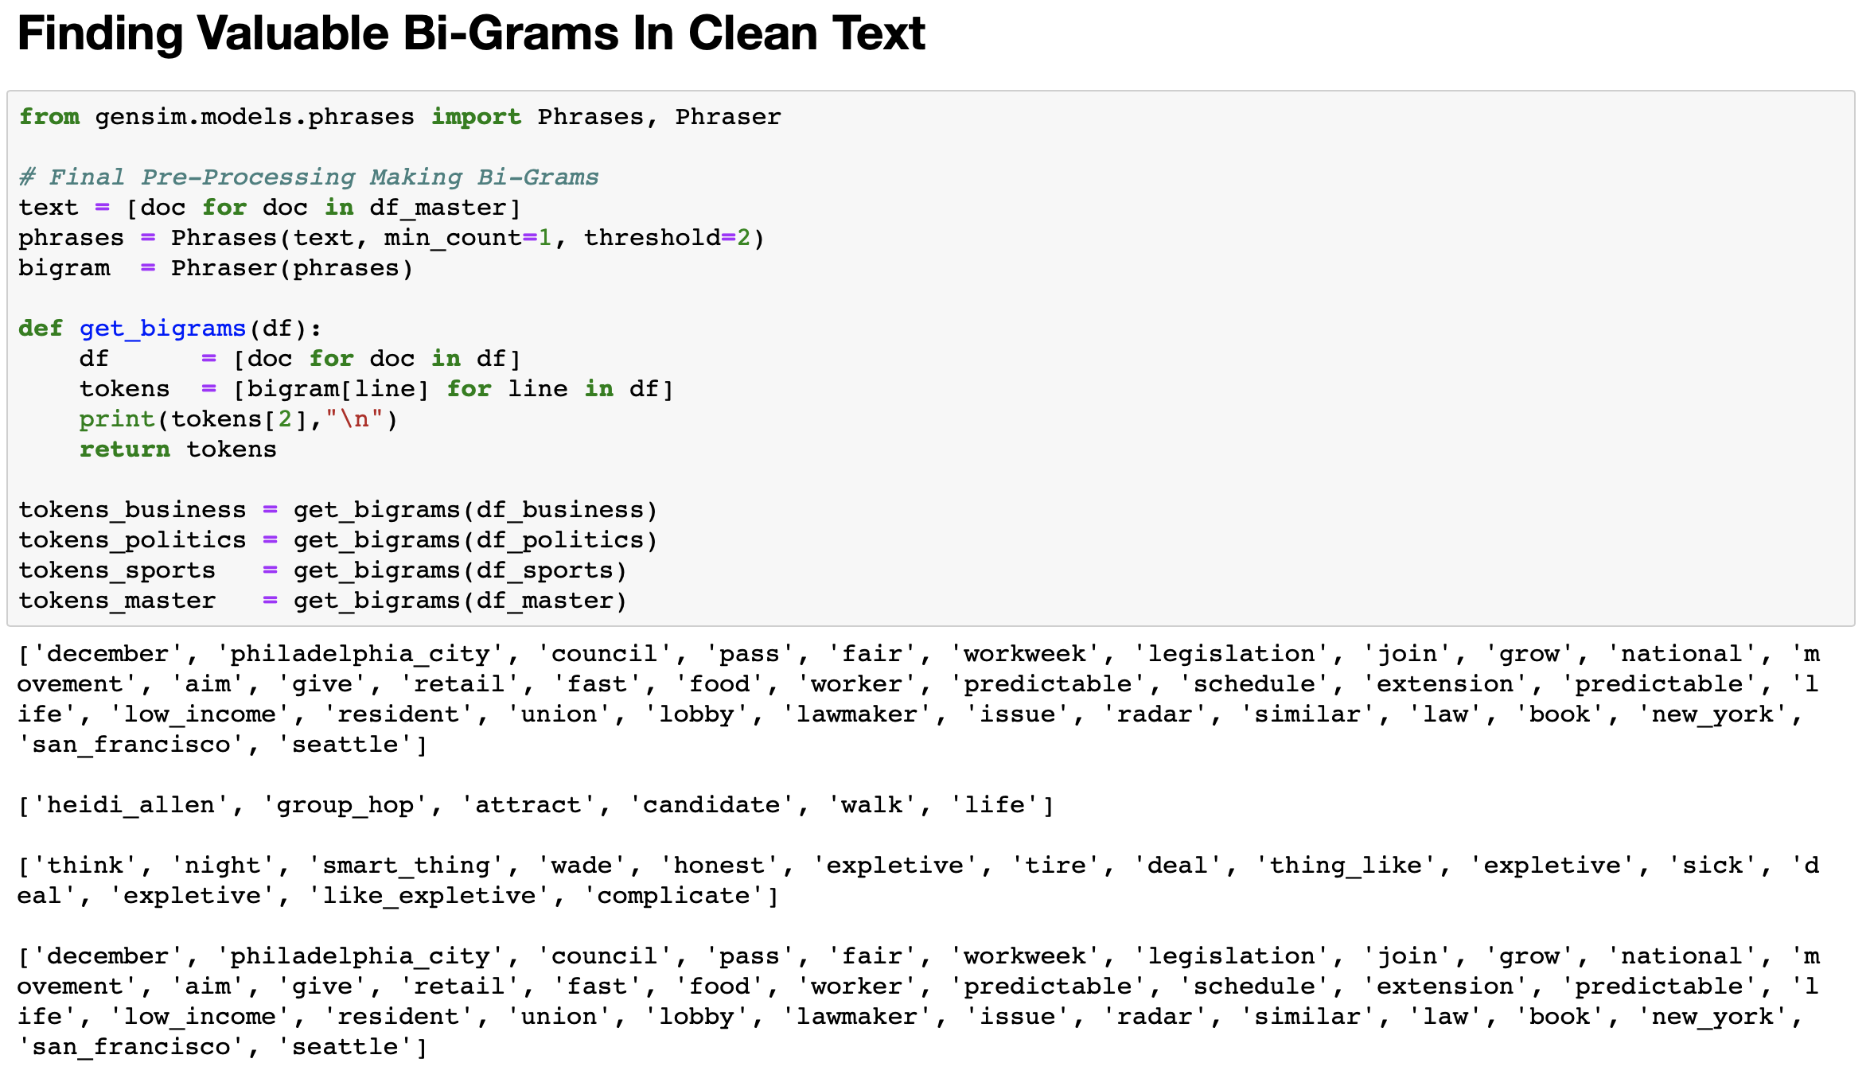
Pre-Processing V

Slide 11
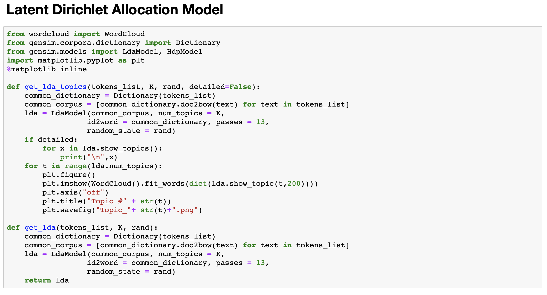
LDA

Slide 12
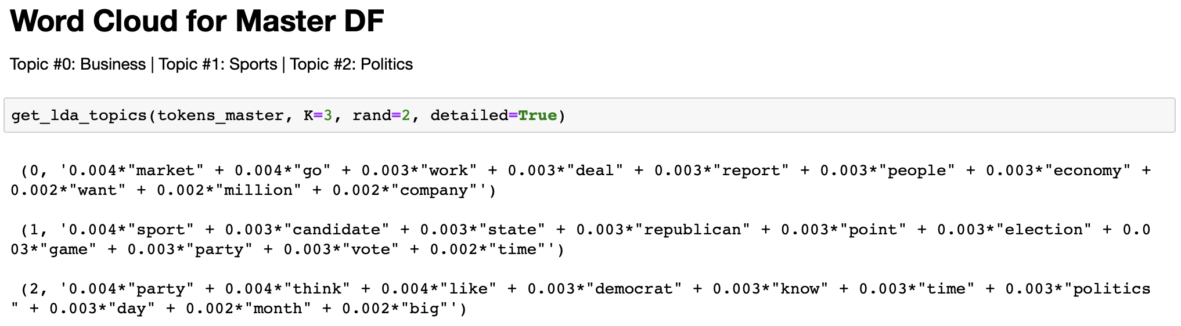
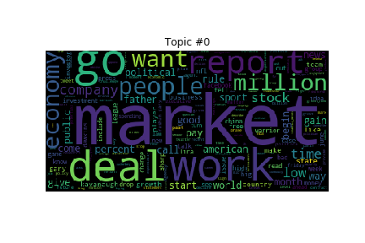
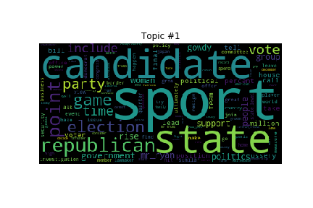
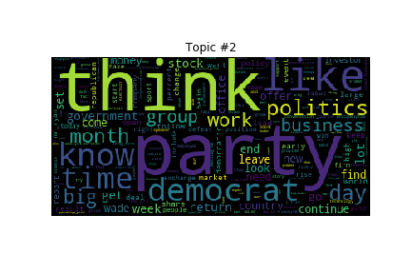
Word Clouds I

Slide 13
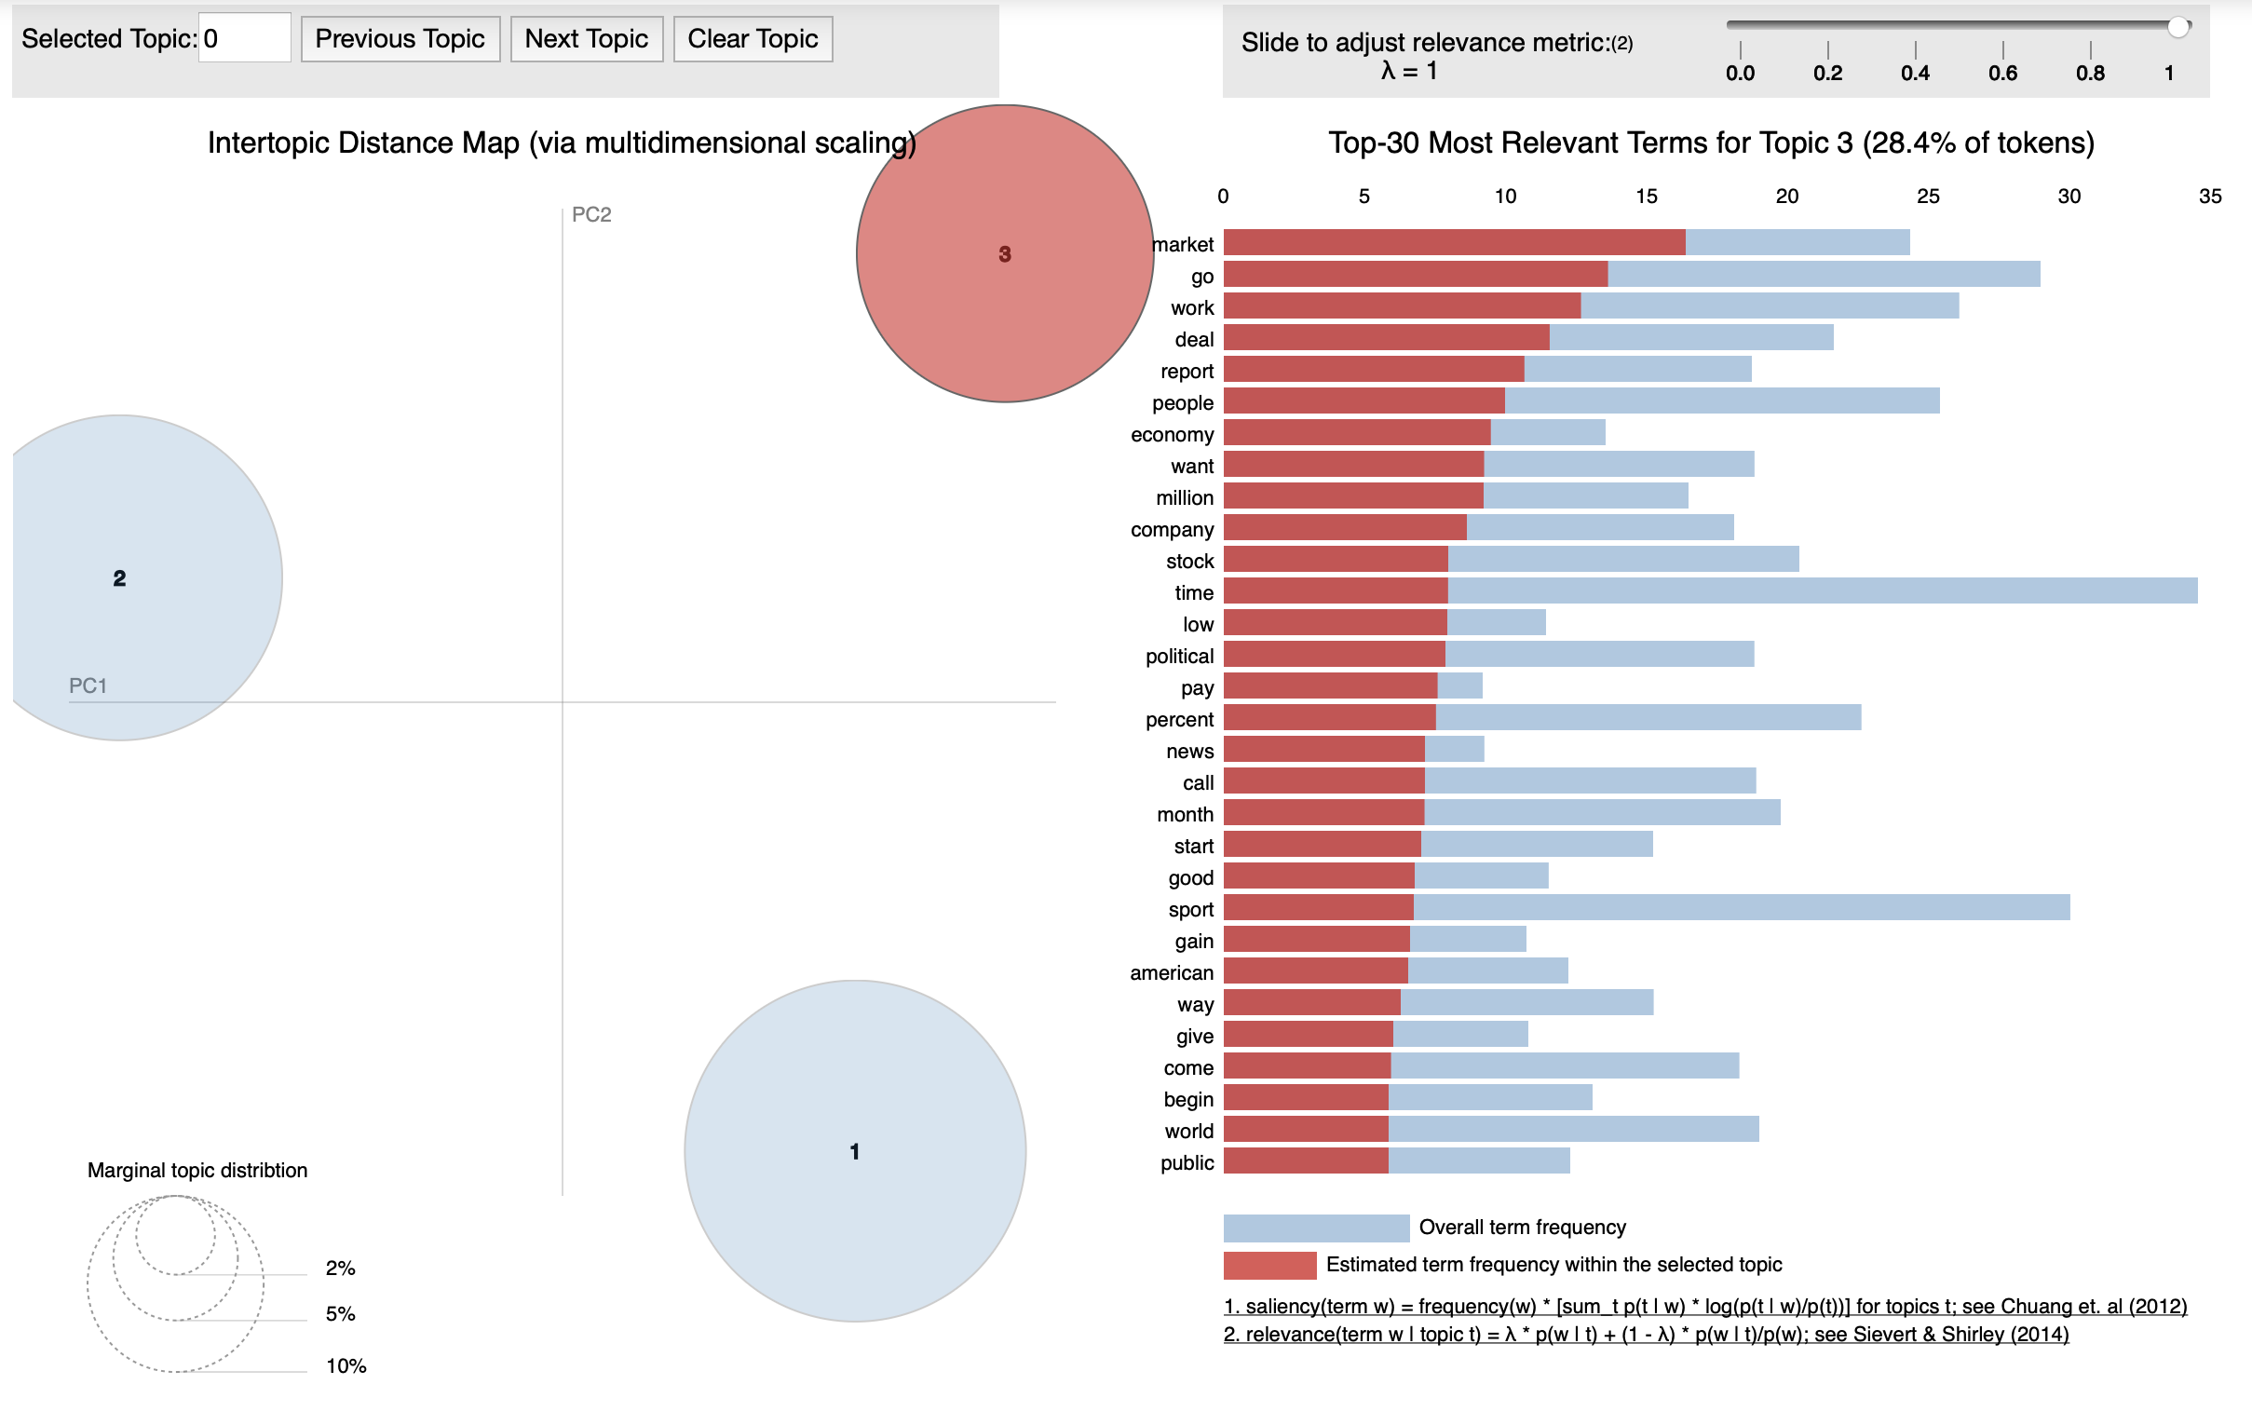
pyLDAvis - Business

Slide 14
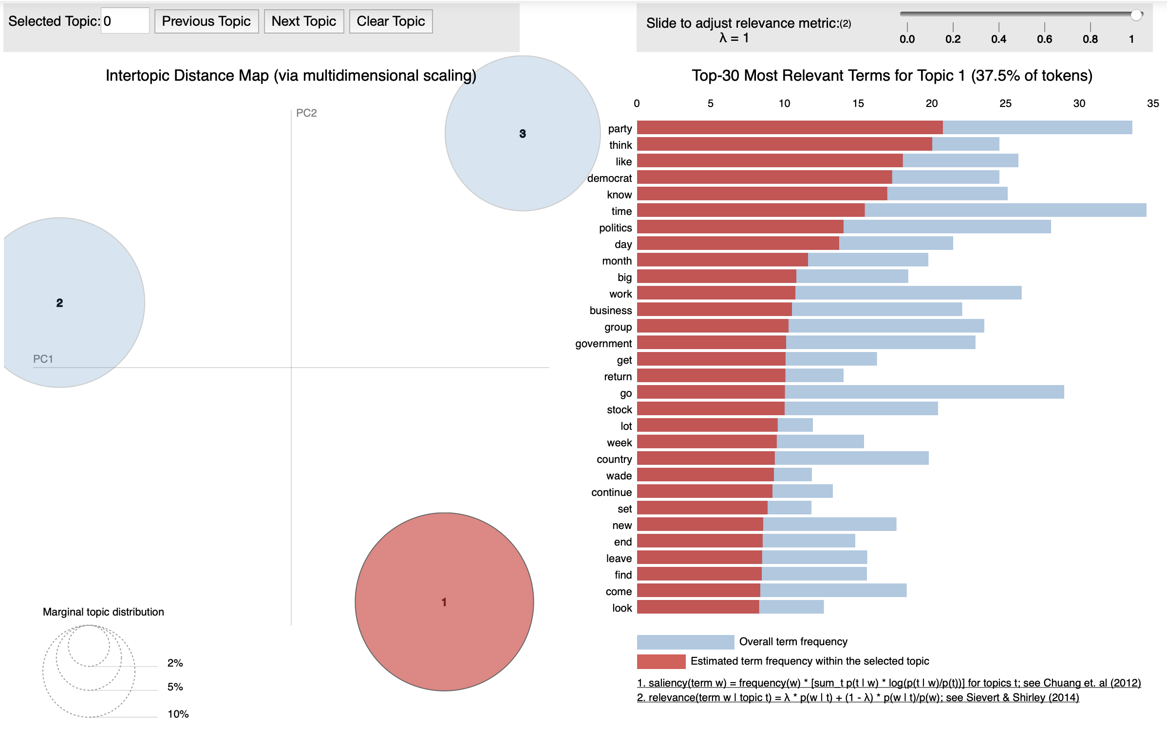
pyLDAvis - Political

Slide 15
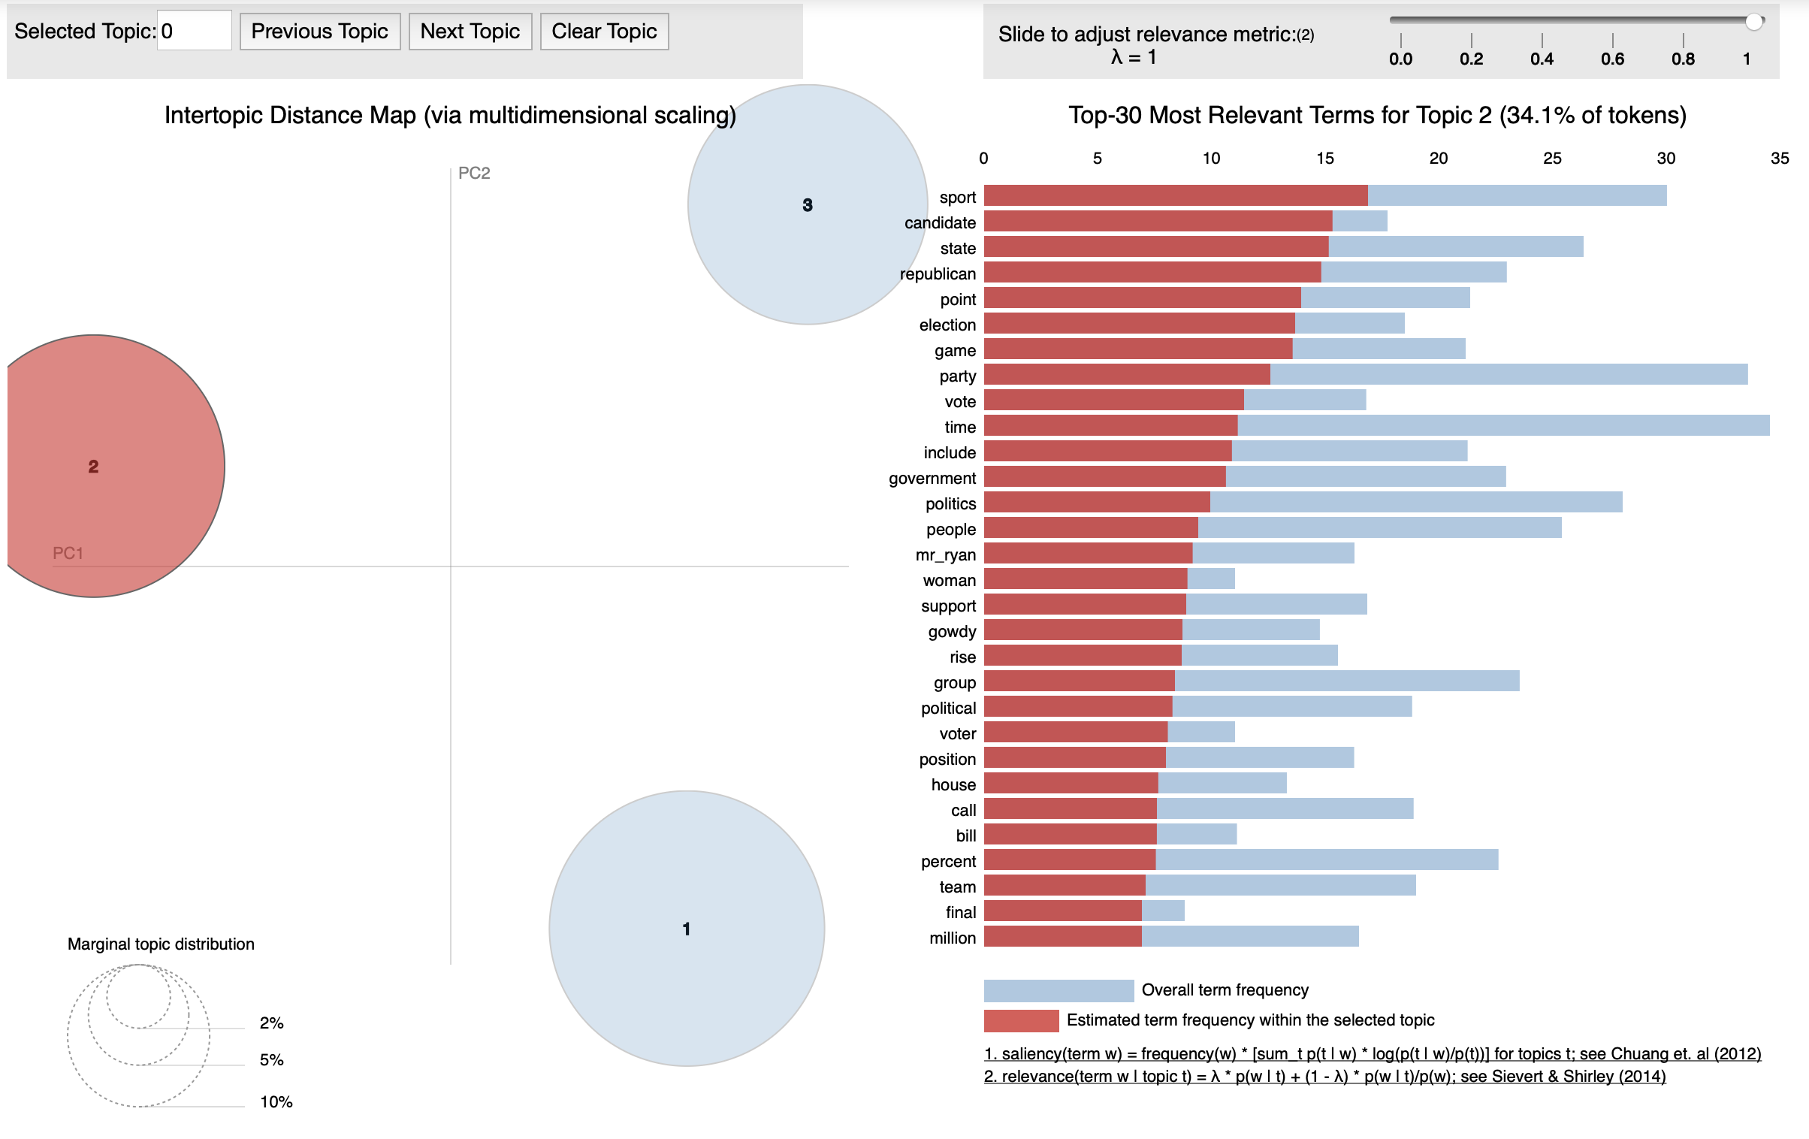
pyLDAvis - Sports

Slide 16
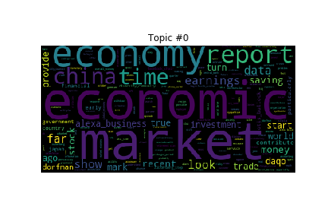
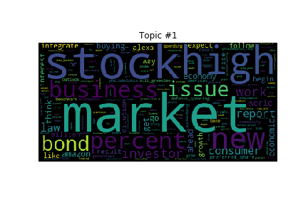
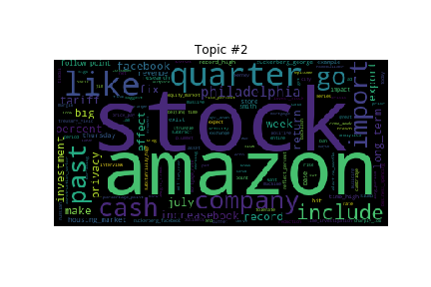
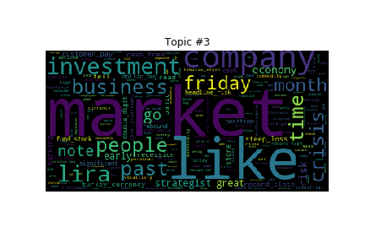
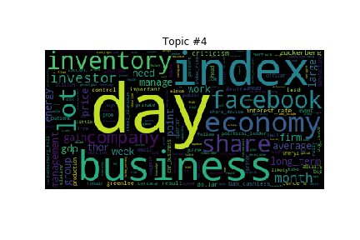
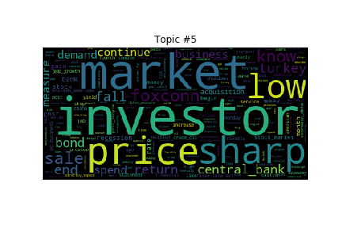
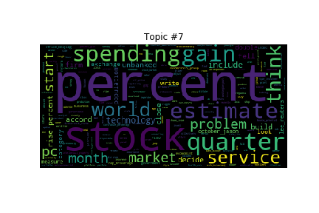
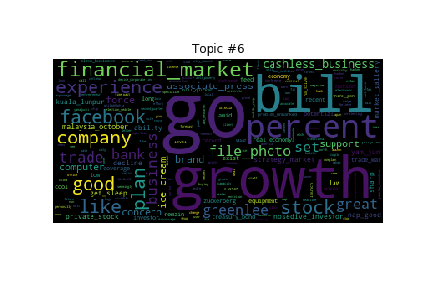
Word Clouds II

Slide 17
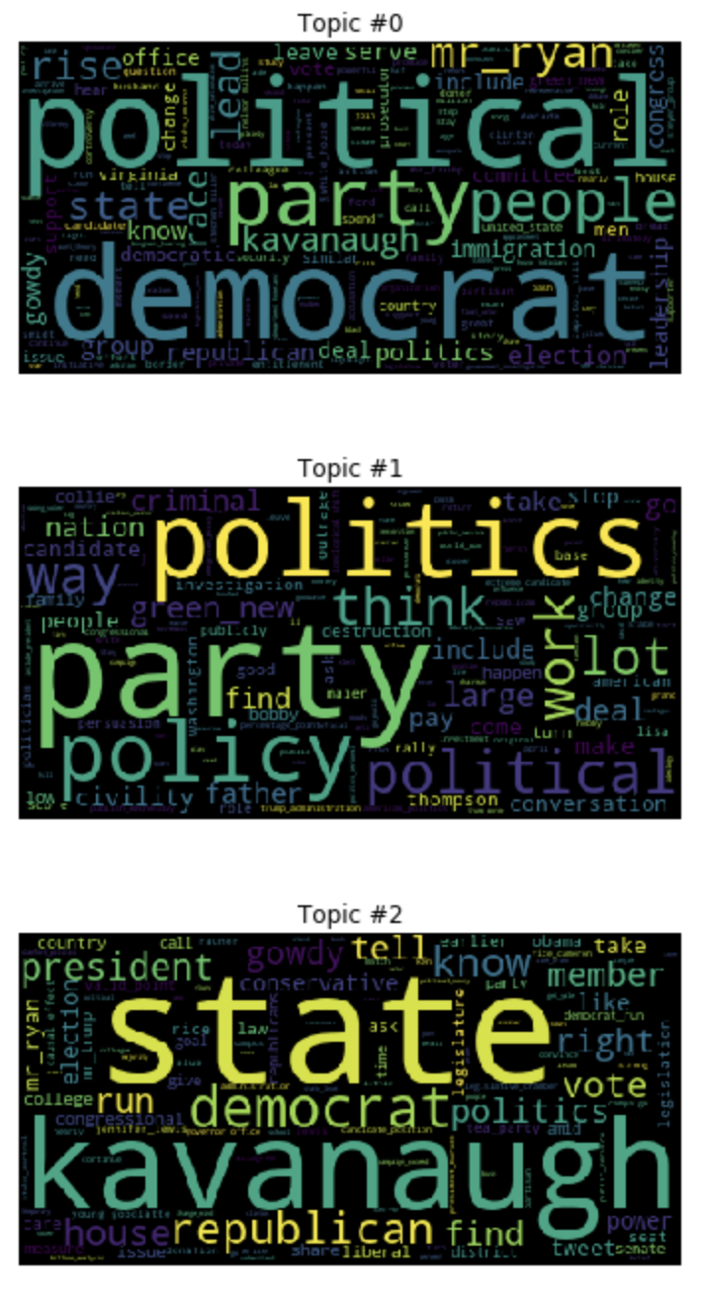
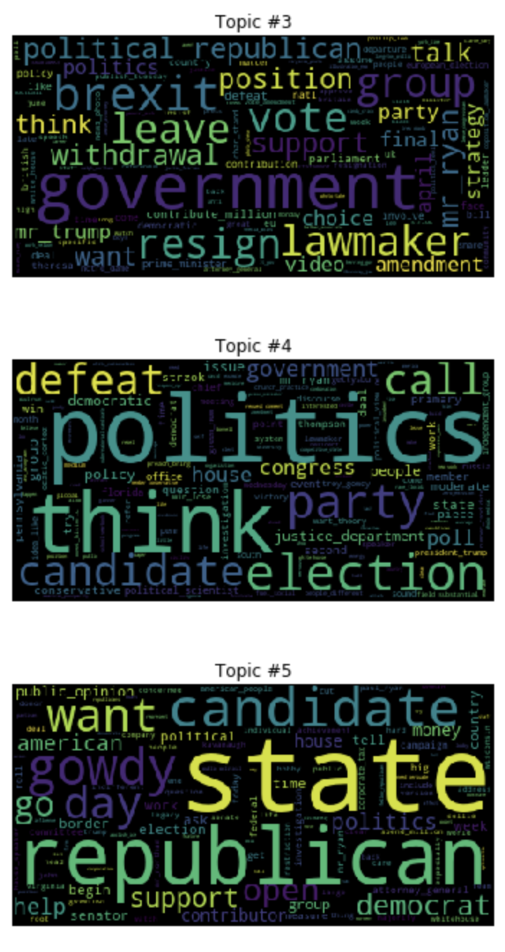
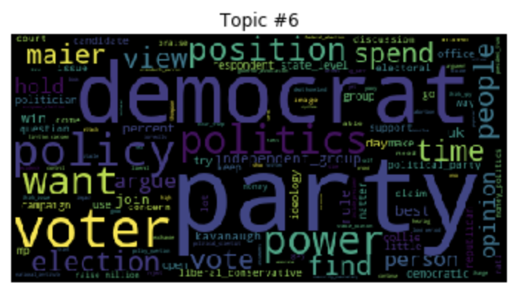
Word Clouds III

Slide 18
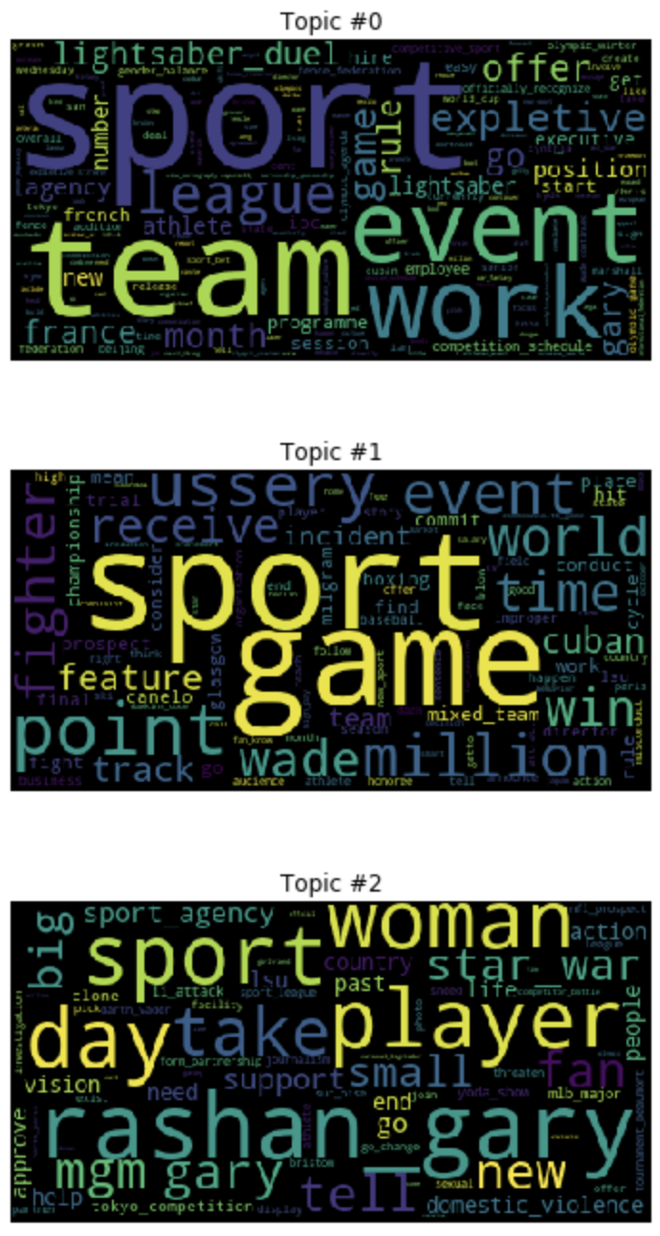
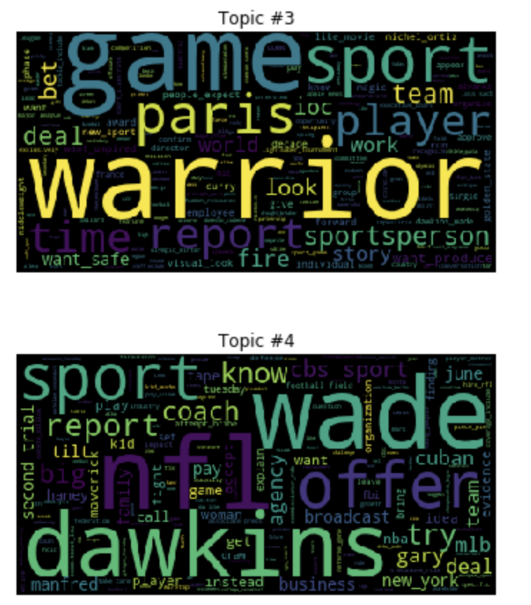
Word Clouds IV

Slide 19
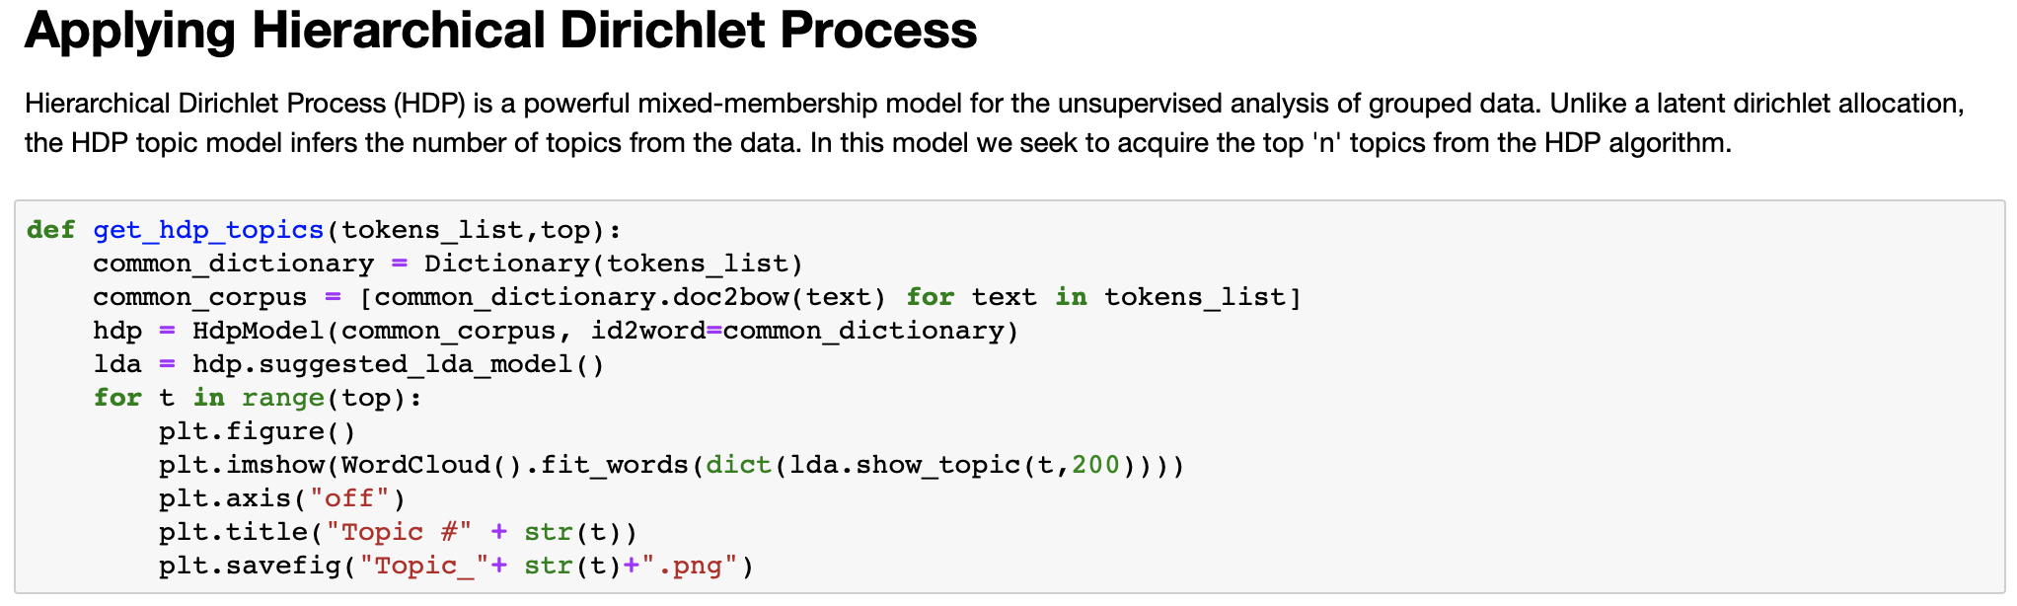
Experimenting with HDP

Slide 21
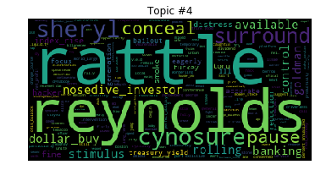
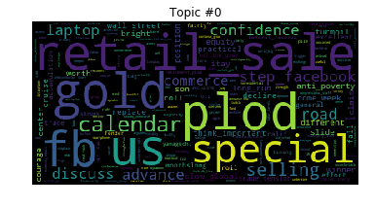
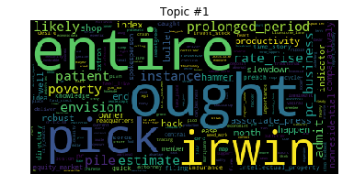
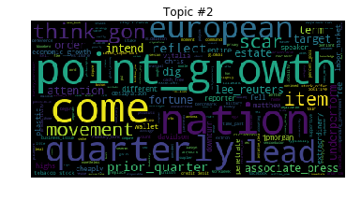
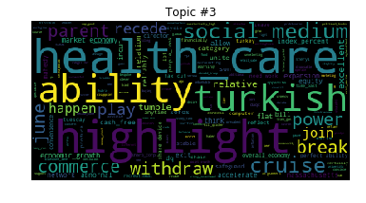
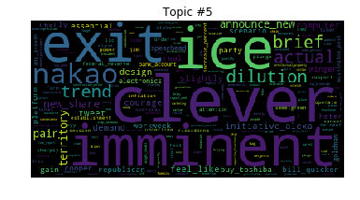
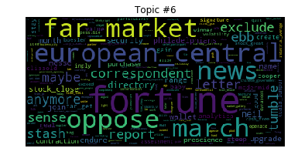
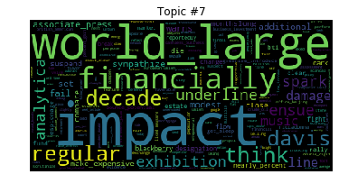
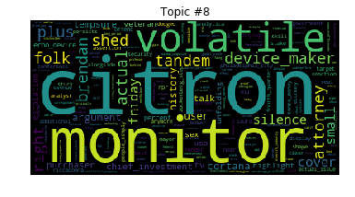
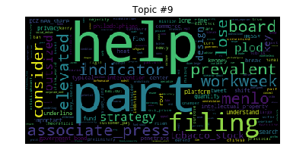
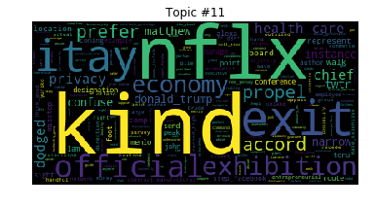
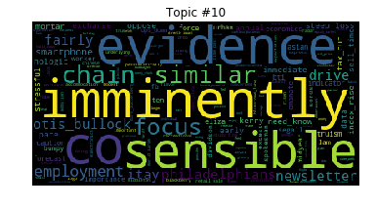
In [ ]:

Slide 23
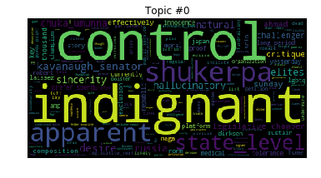
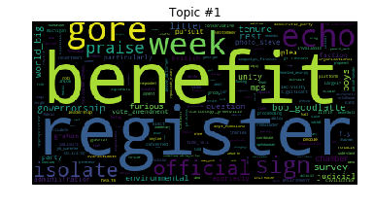
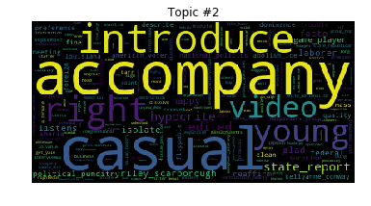
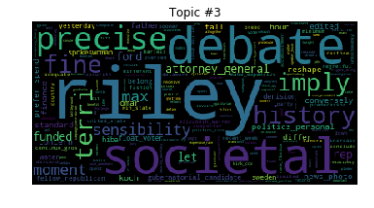
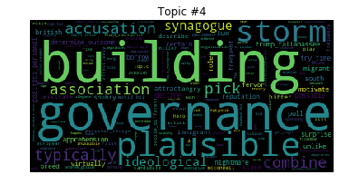








Slide 25













Slide 26

Next Stop: Document Matrix… Start with Crown Jewels… df
Then we concatenate...

Slide 27

Result: Merged Data Frame with 30 Rows (30 Articles)

Slide 28

Document Topic Proportions - Prep
So what does the LDA with K=9 provide?

Slide 29









LDA with K=9 Results in...

Slide 30

Using LDA for Document Topic Proportions Gives Us...

Slide 31

Is this data even useful?... Yes

Slide 32
Now let’s change some LDA parameters and Retry!

Slide 33









K=20 Word Clouds

Slide 34












Slide 35

Using Model & Document Topic Proportions for Analysis

Slide 36

Comparison to Market Prices… Correlation? Possibly

Slide 37

Now let’s test some unseen data...

Slide 38

Methods to Result

Slide 39

Document Topic Proportions

Slide 40
Analyst information discovery & interpretation roles:
Topic Modeling Approach
PAPER SUMMARY

Slide 41
Purpose: To investigate how financial analysts serve their information intermediary role by conducting a large-scale comparison of the textual content of analyst research reports to that of closely preceding corporate disclosures.
Financial Analysts play Informational intermediary role
Informational intermediary can be done in two ways : Discovery Role & Interpretation Role
A topic modeling approach called latent Dirichlet allocation (LDA) is used to extract analyst report AA and conference calls CC and Battery validity test is used to verify LDA
FINDINGS: Analysts spend an average of 31% of their discussion on exclusive topics and 69% of their discussion focuses on conference topics

Slide 42

This table presents the 20 most frequent words in each of the top 10 topics in the capital goods and health care equipment and services industries
This table validates the effectiveness of the LDA algorithm in identifying distinct, and economically meaningful topics in conference calls and analyst reports.

Slide 43

CAR[0, 1] α1Tone_Discovery+ β1Tone_Interpret + γ1Tone_CC +Controls+ ε,
The summary statistics reported in show that both mean values of Tone_Discovery and Tone_Interpret are positive (0.188 and 0.217, respectively), consistent with the overall analyst optimism documented in the literature.

Slide 44
Can analyst research reports provide value to investors without discovering new information or interpreting corporate disclosure using new languages.
Pearson Chi squared was used
Findings : We find that there is a positive and significant coefficients for all tone variables. indicates the confirming value provided by analysts. That is, by selectively repeating CC topics, analysts attract and direct investors’ limited attention to what is important from managers— confirming these topics’ usefulness

Slide 45
Key Takeaways
31% of an analyst prompt serves an information discovery role. And 69% of the discussion in a prompt serves information interpretation role Suggesting that both analyst information discovery and interpretation roles are substantial.
Analyst prove a lot of value to the capital market research
That is, by selectively repeating CC topics, analysts attract and direct investors’ limited attention to what is important from managers— confirming these topics’ usefulness

Slide 46
Latent Dirichlet Allocation (LDA)
Developed in 2003
Use a statistical generative model to imitate the process of how a human writes a document
Reduce the extraordinary dimensionality of linguistic data, based on word co-occurrences in the same document
Advantages over manual coding (cost,

